Slide 1
Technology Transformation Project
Patrick Desbrow
Control Phase Tollgate Review

Slide 2
BPM Project Summary
Problem Statement
The Client System Group (CSG) spends approximately 277 hours or $25,000 to deliver a single study on the existing Compass web deliverable.
There are too many individual steps in a single study. The existing process is manual and requires a great deal of checking to ensure accuracy. In addition, it is also susceptible to errors and potential rework.
Metric
Y1: Labor hours per syndicated study
Defect Definition
D1: Total time > Labor Hours
D2: # of Errors
Objective
Currently a syndicated study in the Financial Services and Insurance (FS&I) practice area takes approximately 277 hours of IT labor to deliver on the Compass web site. The aim is to:
  Decrease this by 72% or 200 hours of labor for a syndicated research study.
Current Baseline
  Average labor hours for creating and checking study deliverables: 277 labor hours
  2.0 person programming teams work on each study implementation
  All hardware and software costs are part of the Solution Framework project
Projected Benefits
  Based on project chargeback rates per hour, There will be a cost saving of $15,433 per study implementation
  There is at least $100,000 savings if only seven to nine current insurance practice area studies move over to this new process
JDPA – Insurance Practice Business Process Redesign

Slide 3
Agreed Upon Recommendations
Develop the necessary tools that researchers can use to eliminate or reduce the manual steps to produce and check client deliverables*
Improvement Task | Owner | Due Date** | Status**
Research Tool - Web Site Version 1 Create research tool shell Implement Process Flow dashboard Implement Matrix File Discrepancy Reporting web page Implement Questionnaire Properties web page Beta test the application Create the requested changes to the site Review requested changes Client sign off | Patrick Desbrow Research Research | 12/19/08 | Complete Complete Complete Complete Complete Complete Complete Complete Complete
Web Site and Warehouse Integration | Technology Tm | 01/15/09 | Complete
*Note: the improvements are a subset of the broader R2T2 initiative for improving existing business processes
**Note 2: Last updated April, 2009
JDPA – Insurance Practice Business Process Redesign

Slide 4
Agreed Upon Recommendations (continued)
Improvement Task | Owner | Due Date* | Status*
Research Tool - Web Site Version 2 Implement Performance Analysis web page Implement Charting Definition web page Implement Data Import web page Implement Index Model Reporting web page Implement Portal Publishing pages Implement Data Export web page Beta test the application Create the requested changes to the site Review requested changes Client sign off Go/No Go Statement from Stakeholder | Patrick Desbrow Research Research Research K. Keegan | 3/20/09 (Updated 04/03/09) | 100% 100% 100% 100% 100% 100% 90% 100% 100% 90%
Web Site and Warehouse Integration | Technology Tm | 07/15/09 | In progress
*Note: Last updated April, 2009
JDPA – Insurance Practice Business Process Redesign

Slide 5
Open Items
Improvement Task | Owner | Expected Completion Date*
Research Tool - Web Site Version 3 Implement Sampling & Data Collection page Implement Performance Analysis administration Implement mTAB & SPSS Export feature Integrate CRD deliverables into the database Implement the Home page publishing Quality Assurance Client sign off | Patrick Desbrow | 5/30/09
Research Tool - Web Site Version 4 Incorporate data cleaning via the data warehouse Incorporate matrix creation via the data warehouse Implement Advanced Home Page publishing Implement Imports/Export features for remaining page in the tool Quality Assurance Client sign off Go/No Go Statement from Stakeholder | Patrick Desbrow | 7/15/09
JDPA – Insurance Practice Business Process Redesign
*Note: Last updated April, 2009

Slide 6
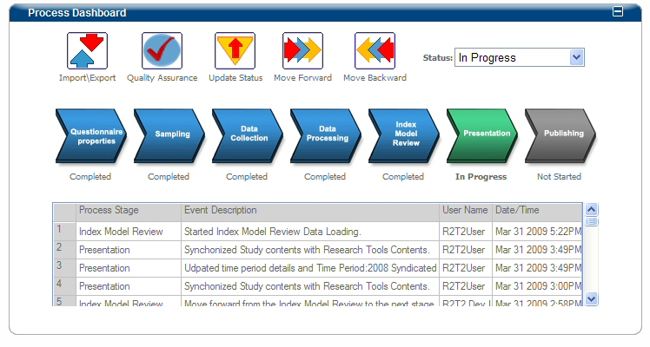
Process Dashboard Workflow
The Process Dashboard shows the stages in the research process lifecycle. The process flow has 7 stages: Questionnaire Design, Sampling, Data Collection, Data Processing, Index Model Review, Presentation Deliverables, and Publishing.
Each stage is color coded as follows:
Gray – Not Started, Green – In Progress, Red – Issues That needs review, Blue – Completed.
JDPA – Insurance Practice Business Process Redesign
*Note: Last updated March, 2009

Slide 7
Communication/Training Plan
Training for Business Center and the Research Tools (a.k.a. R2/T2)
  Training materials have been developed
  The Training department will pilot the class in early April 2009
  All researcher & technologist that work on studies will participate in training
  CSG project managers will work with research to aid in the transition
  A support team will be in place for the remainder of the year
  A development team will focus on enhancements and bug fixes
Communicate Plan
  Corporate Communication will create a set of communications promoting the value of the tool and the availability of training
  Patrick Desbrow and will conduct quarterly road shows to highlight the features of the tool
  Cathie Baker will assume training and communication responsibilities on the research side
Establish and communicate improvements across JDPA
  Ensure that all research new hires have a R2T2 orientation as part of the training
  All training and communication tasks should be completed by August 2009
JDPA – Insurance Practice Business Process Redesign

Slide 8
Control Plan
Ensure the new research back-office tools reduce labor costs while maintaining quality for all the Financial Services and Insurance (FS&I) syndicated studies in the JDPA Business Center (a.k.a. Compass 2.0) environment
Monitor the overall CSG labor hours (Target: 133 hours or $12,000 per study)
  Gather requirement
  Loading data
  Creation of presentation deliverables (charts, reports, etc…)
Monitor the number of quality related errors that occur on the project (Target: Zero errors)
  Number of issues report by the research team after the study was released
Data collection and monitoring
  Project labor hours are already extracted from the time keeping system on a monthly basis
  A research satisfaction survey will be developed to determine the number
  of quality related issues that occurred on each study
  This data will be used to populate a monthly dashboard
JDPA – Insurance Practice Business Process Redesign

Slide 9
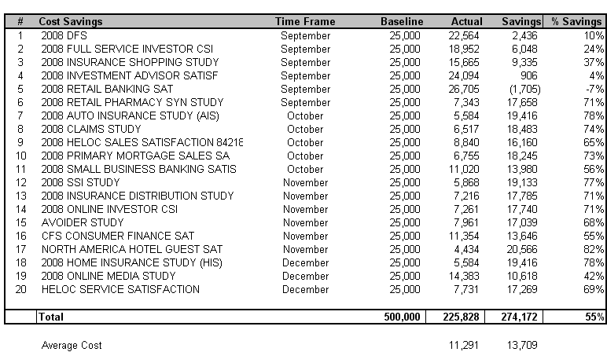
Project Benefits Quantification
20 studies where executed in 2008. As a result, there was a total of $274,172 or 55% saving across these studies. This is an average of over $13,000 per study. This allows time for researchers to create additional value in their deliverables.
Source: Full labor hours capture through Timepiece. Contract labor hours captured through ActTime
JDPA – Insurance Practice Business Process Redesign
Notes:
The initial project charter was still rather broad – identifying a need for improvement within the broad spectrum of executing a mail-based study. In that regard, it was important for us to walk through the process and talk to process owners, practice leads, and research project managers to identify the key stakeholders and internal customers. This helped us understand the pain points throughout the process
From the walk-through and interviews, we learned a few things:
1. The existence of a number of handoffs and verification steps that have been institutionalized in our processes
2. An understanding of how scope of work changes and input variation impact our Client Operations (i.e. research production) activities, and
3. The type of data available and necessary for us to gather and analyze in order to prioritize our pain points

Slide 10
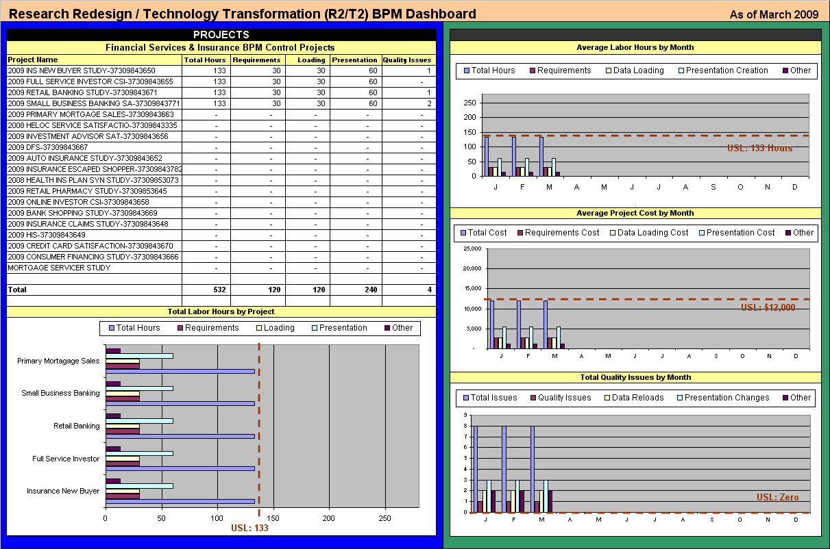
Scorecard Example
JDPA – Insurance Practice Business Process Redesign

Slide 11
Audit Plan
Audit Objective:
Measure the effectiveness of the improvements of the research back-office tools for all the Financial Services and Insurance (FS&I) syndicated studies in the JDPA Business Center (a.k.a. Compass 2.0) environment
  Labor/process improvement associated with Version 1 of the research tool
  Number of quality related errors that occur on the project
  Completion of tasks associated with Version 2 of the research tool
Audit Date: July 2009
Responsibility: Patrick Desbrow / Eric Crudo
Deliverable: Audit report presented to Rich Belanger
JDPA – Insurance Practice Business Process Redesign

Slide 12
APPENDIX
JDPA – Insurance Practice Business Process Redesign

Slide 13
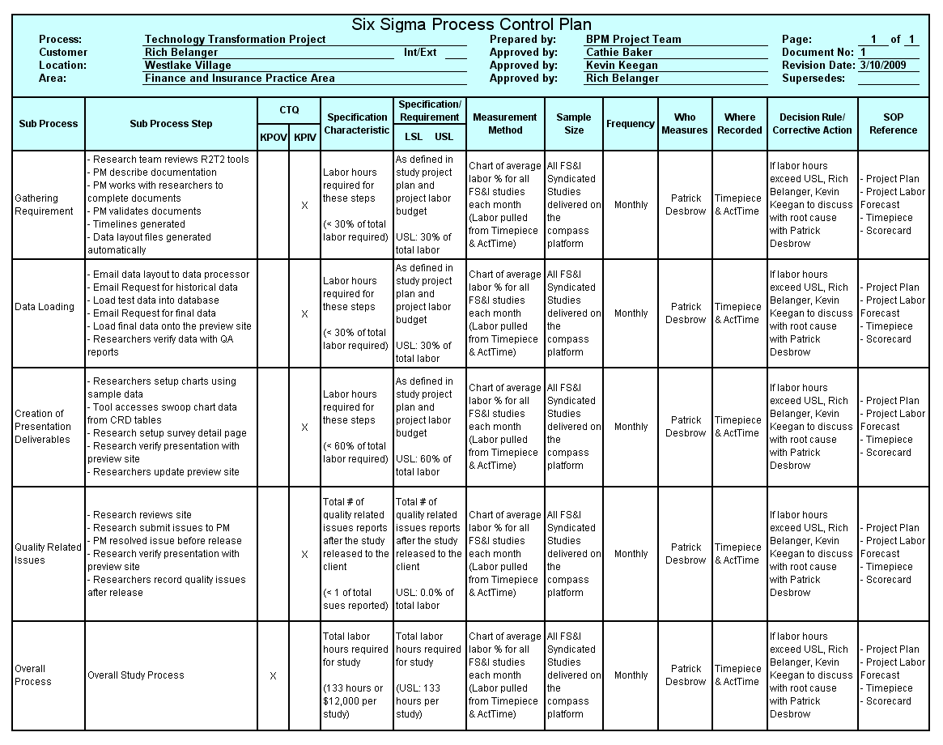
Control Plan Details
JDPA – Insurance Practice Business Process Redesign

